Slide 1

IoT Smart Energy
Group # 2
Course: ITAI-2277
Energy Optimization for Airbnb Properties and building management
Team Members:
Tien Manh Nguyen
Virginia Mccoy
Enrique Quintero
Ali Shan

Slide 2
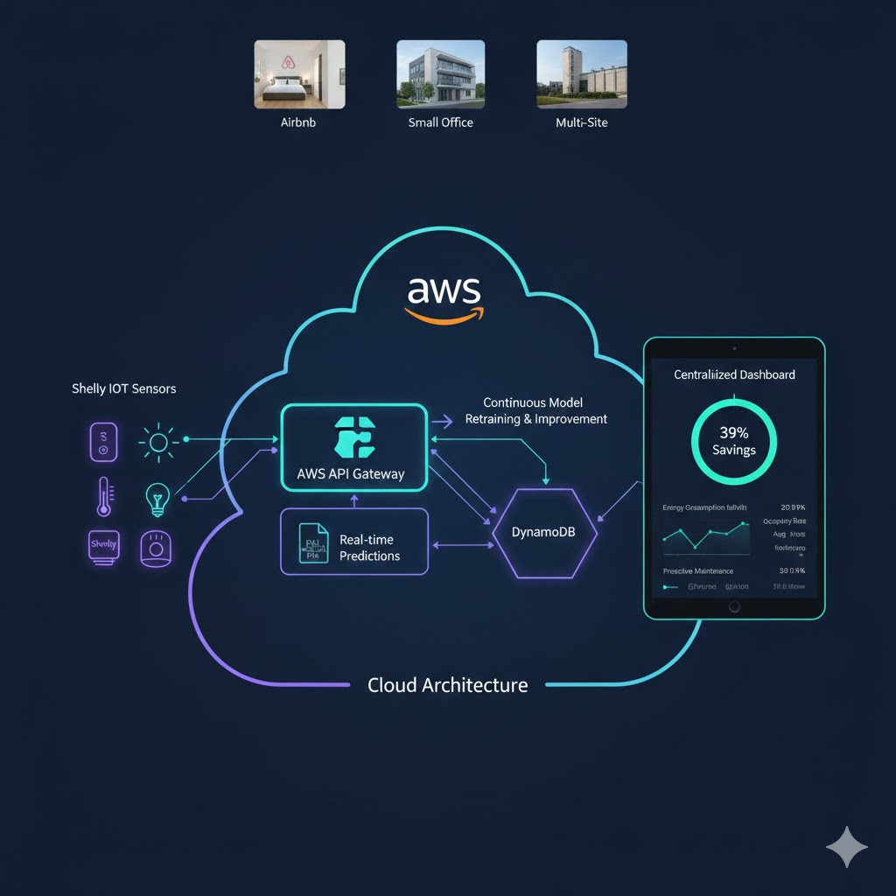
Project Objective: Smart Energy Optimization Platform
The goal of this project is to build an Integrated Smart Energy Platform that combines IoT sensors, AI models, and a cloud architecture to optimize energy consumption in Airbnb, small businesses, and multi-site environments.
The solution addresses real-world problems such as excessive consumption, unexpected outages, and inefficient space utilization through real-time monitoring of electricity, occupancy, lighting, and temperature, along with predictive models capable of detecting anomalies, forecasting costs, and anticipating failures.
The ecosystem operates on AWS: Shelly sensors send data to the API Gateway, which is processed by a Lambda function containing the model's PKL files to run instant predictions. The results are stored in the database, enabling continuous feedback and model retraining to improve its accuracy over time.
A centralized dashboard allows for monitoring all properties and visualizing key metrics, enabling data-driven decisions. Together, this platform delivers a complete, production-ready solution that integrates IoT, AI, and automation to reduce costs, prevent failures, and improve energy sustainability.

Slide 3
Solution Outline (Part 1)
Integrated Smart Energy Optimization Platform
Our solution delivers a unified IoT + AI ecosystem designed to predict, optimize, and automate energy usage across Airbnb properties and small business environments. The platform integrates three core layers:
1. IoT Sensing Layer
Real-time data from Shelly 2.5, EM meters, presence sensors, light sensors, and temperature feeds.
Continuous monitoring of energy consumption, occupancy, lighting, and environmental factors.
2. AI Intelligence Layer
Machine learning models (PKL) deployed in AWS Lambda for instant predictions.
Forecasting of energy demand, anomaly detection, failure prediction, occupancy analysis, and cost optimization.
Continuous feedback loop that stores predictions and allows model retraining for higher accuracy over time.
3. Cloud Processing & Automation Layer
API Gateway receives IoT data securely.
Lambda runs inference and writes results to the database.
Automated actions (turn HVAC/lights on/off) based on predictions and occupancy patterns.

Slide 4
Solution Outline (Part 2)
End-to-End Cloud Architecture & Decision Platform
4. Data Pipeline & Storage
Multi-layer database architecture: Raw → Silver → Gold feature tables.
Structured time-series ingestion for scalable training and analytics.
Historical records stored to support retraining, trend analysis, and anomaly tracking.
5. Predictive & Automated Decision Engine
Each new IoT event triggers model inference inside Lambda.
System continuously refines predictions using fresh data.
Energy-saving decisions and risk alerts are generated automatically.
6. Centralized Dashboard & User Experience
Web dashboard to manage multiple properties.
Display of energy metrics, predicted anomalies, occupancy status, and cost projections.
Provides data-driven insights for operators to reduce waste and prevent failures.

Slide 5
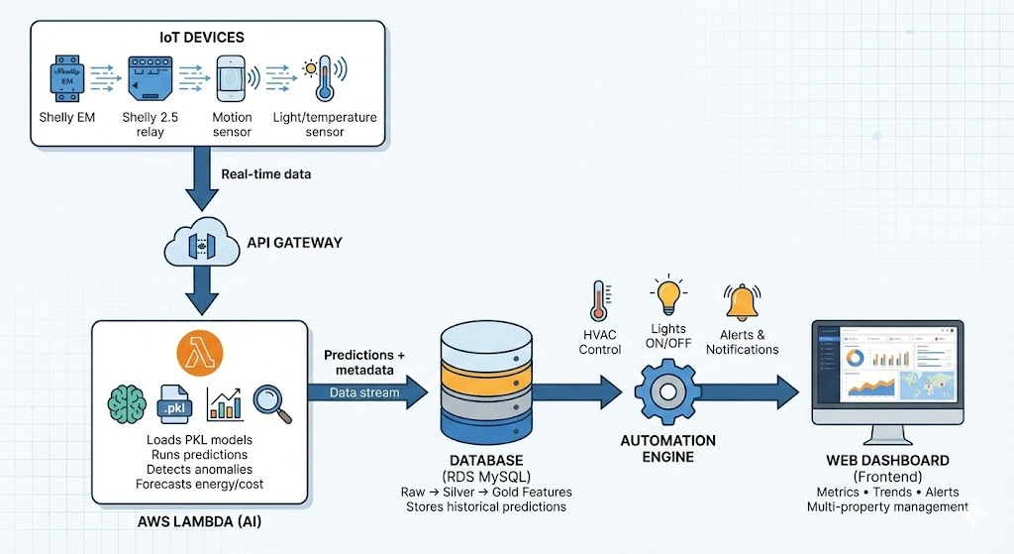
Process Flow

Slide 6
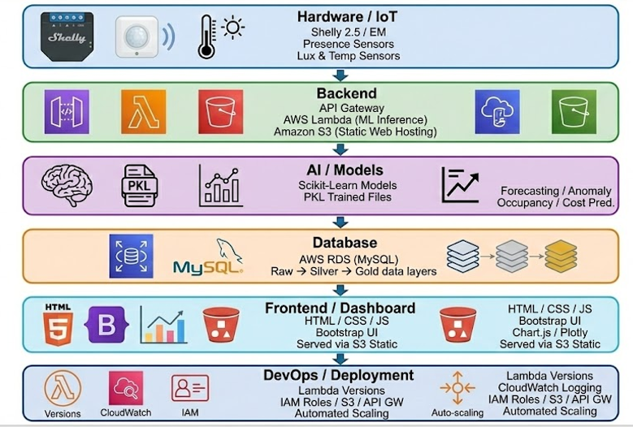
TECHNOLOGY STACK

Slide 7







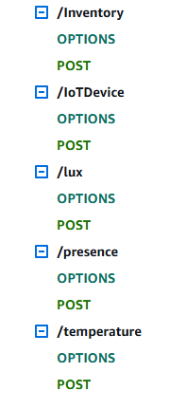

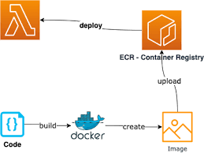

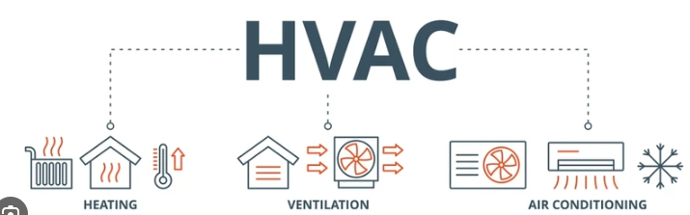



Visual Topology
Prediction
General Sensor – Use IoT Device
Lightning Level - Lux
Human presence – Use presence
Temperatura – Take Room Temperature

Slide 8


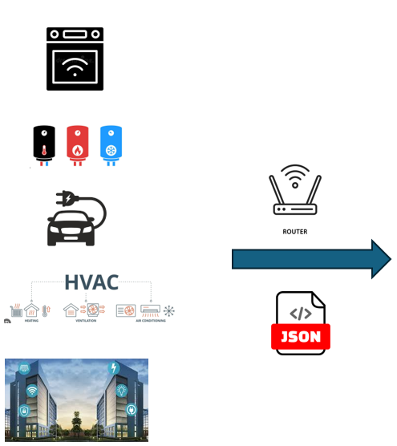
Life Cycle
3. – Make Model
4. – Make PKL Files
5. – Put PKL Files
1.- IoT Dataset
2. - IoT Dataset
Store New Prediction
6. – New Version PKL Files
7. – Cycle Lambda and Take last version PKL Files
8. – Insert new record Database

Slide 9
AI / ML Models Used in the Smart Energy Platform MODEL 1 — Failure / Anomaly Detection Model
Purpose
Detect abnormal or unsafe electrical behavior (e.g., overload, overheating, voltage spikes) to predict equipment failures early.
- energy_usage
- temperature
- humidity
- voltage
These features simulate environmental and electrical conditions that correlate with failure events.
Modeling Approach
- RandomForestClassifier with 100 estimators
- StandardScaler
- Train/Test split 80/20
Evaluation Metrics
All metrics achieved 0.95, including:
Accuracy
Precision
Recall
F1-score
Confusion Matrix
Generated Artifacts
- model.pkl – trained model
- scaler.pkl – preprocessing scaler - Stored and loaded in AWS Lambda for inference.
Real-Time Output
- normal
- anomalous (with probability score)

Slide 10
AI / ML Models Used in the Smart Energy Platform MODEL 2 — Room Occupancy Classifier (Binary Occupancy: 0 / 1)
Purpose
Predict whether a room is currently Occupied or Empty using a multi-sensor IoT dataset.
Sensor Inputs
Temperature
Humidity
CO₂ concentration
Light (lux)
Sound (dB)
Motion (0/1)
Modeling Techniques
RandomForestClassifier (100 trees)
Train/Test split: 80/20
Feature importance and correlation analysis
Dataset Characteristics
500 samples generated every 5 minutes.
Multi-room simulation (Room A/B/C).
Multiple visualizations:
Light vs Occupancy (Page 4)
CO₂ vs Occupancy (Page 4)
Correlation heatmap (Pages 4–6)
Evaluation
Accuracy: 1.00
Perfect precision and recall
Confusion matrix with zero errors
Why It Works Well
Motion + CO₂ + Light have strong predictive power
Indoor climate changes correlate with human presence
Live Output for Automation
0 = Empty → Turn OFF HVAC/Lights
1 = Occupied → Keep ON

Slide 11
AI / ML Models Used in the Smart Energy Platform MODEL 3 — Cost Optimization Classifier
Purpose
Classify energy consumption states as:
Normal
Abnormal / High Cost
Critical for alerts and cost-saving recommendations.
Features
energy_usage
temperature
humidity
voltage
Model Type
RandomForestClassifier
StandardScaler + Train/Test split
Evaluation
All metrics 0.96
Generates PKL files for Lambda
Usage in Platform
Alerts user when consumption is higher than expected baseline
Suggests actions:
Turn off appliances
Adjust HVAC
Detect inefficiencies in real properties

Slide 12

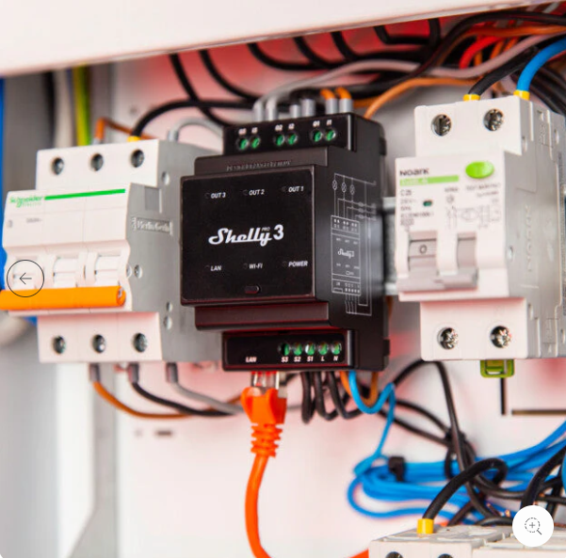

Hardware
Shelly EM / Shelly 2.5 (Energy Meters)
Role: Primary energy-monitoring devices that measure real-time electrical consumption at circuit level.
Capabilities:
Power (W), Voltage, Amperage, Energy (Wh) measurements
Millisecond-level sampling for accurate prediction
WiFi connectivity for cloud transmission
Over-consumption detection
Why It Matters: Provides the most critical signals for anomaly detection, forecasting, and cost optimization.
Presence / Motion Sensors
Role: Detect human presence to automate HVAC/lights and feed the Occupancy Model.
Capabilities:
PIR (Passive Infrared) motion detection
Occupancy flag (0/1)
Low-power and high-sensitivity sensing
Impact: Drives the Occupancy Classifier and People Count model, enabling automatic energy savings.

Slide 13
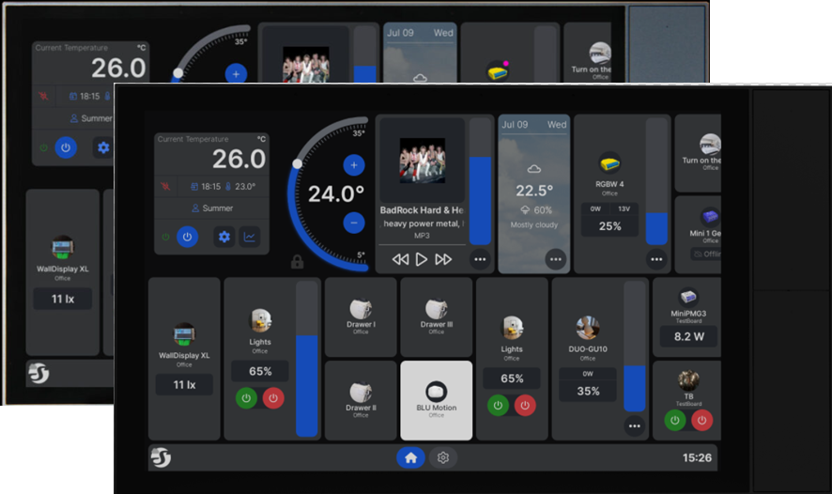
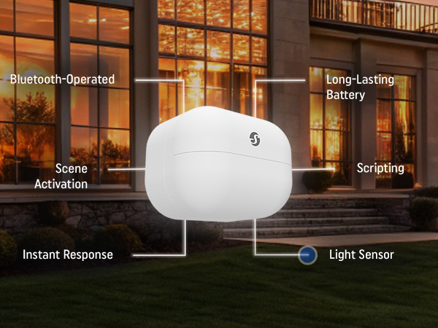

Hardware
Lux (Light) Sensors
Role: Measure illumination levels to determine occupancy patterns and environmental context.
Capabilities:
High-range lux measurement (0-2000+)
Noise filtering for stable readings
Impact: Light levels correlate strongly with occupancy and daily usage patterns.
Temperature & Humidity Sensors
Role: Track environmental conditions inside the room, providing data for failure prediction and occupancy estimation.
Capabilities:
Indoor temperature accuracy
Humidity measurement
Significant correlation with the People Count model (as shown in PDF)
Impact: Identifies HVAC load, heat generated by occupants, and contributes to anomaly detection.

Slide 14
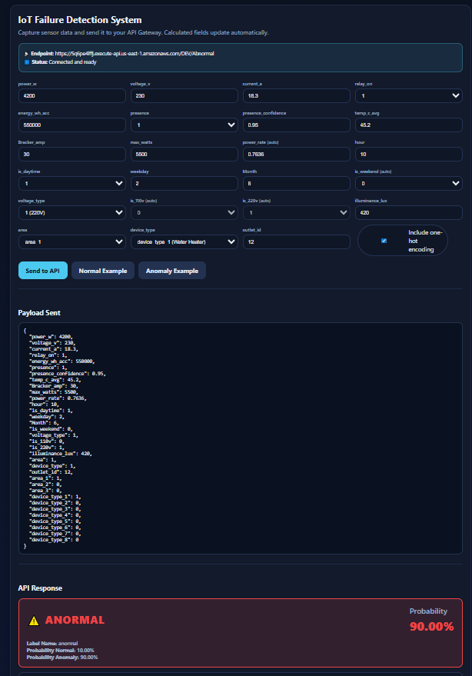
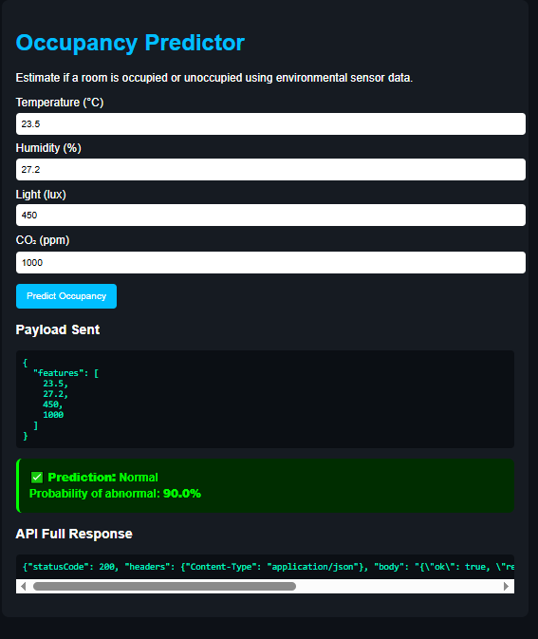
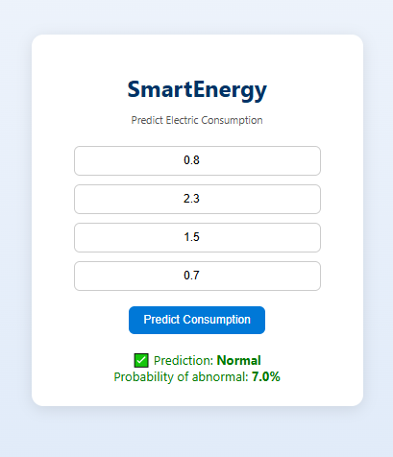
Front end for manual predictions. This is used to emulate a sensor input.
https://sireieiplus.s3.us-east-1.amazonaws.com/SmartEnergyDocs/iot-Smartenergy-predictor+(1).html
https://sireieiplus.s3.us-east-1.amazonaws.com/SmartEnergyDocs/OccupancyPrediction.html
https://sireieiplus.s3.us-east-1.amazonaws.com/SmartEnergyDocs/SmartEnergyCostenergy.html

Slide 15
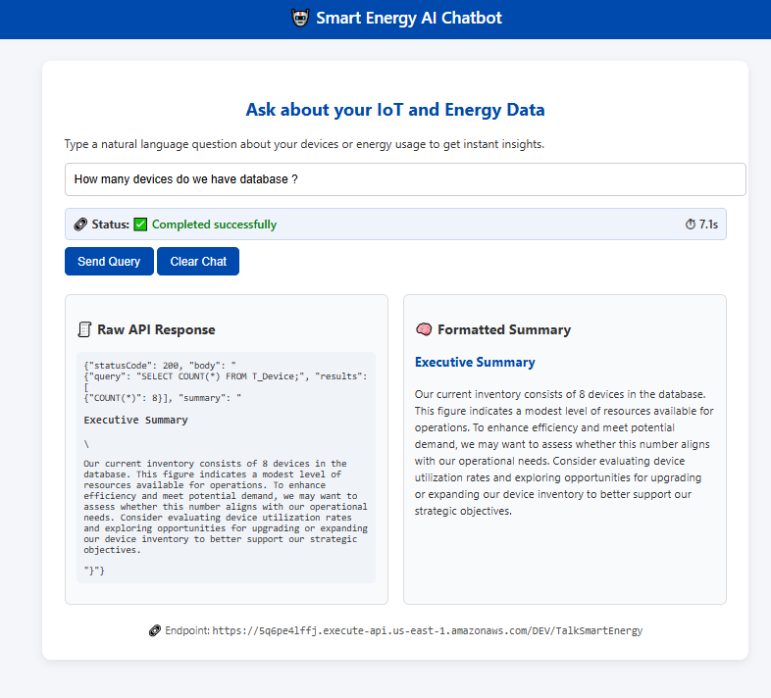
Smart Energy Dashboard & AI SQL Chatbot
This dashboard includes an integrated AI-powered SQL chatbot that allows users to query their IoT and energy data using natural language. Instead of writing SQL manually, the system uses an OpenAI model to dynamically generate SQL queries based on the user’s text request.
The prompt sent to the AI model includes the full database schema, enabling the chatbot to understand table structures, relationships, and field names so it can create accurate and safe SQL statements in real time. Every request is executed through an AWS API Gateway → Lambda pipeline, which validates and runs the generated SQL against the RDS database.
To optimize cost and ensure responsible use, the chatbot operates with a 30-second execution timer, preventing long or expensive operations. The dashboard displays both:
The raw API response (SQL query, execution result)
A human-friendly formatted summary generated by the AI
This tool allows administrators to instantly access insights such as device counts, occupancy patterns, anomalies, or energy usage trends without needing technical knowledge, making the platform significantly more accessible and data-driven.
https://sireieiplus.s3.us-east-1.amazonaws.com/SmartEnergyDocs/smart_energy_chatbot.html

Slide 16
DEMO DEL PRODUCTO

Slide 17
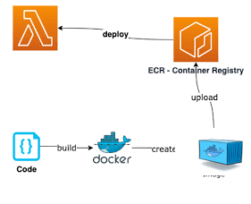
TECHNICAL SLIDES - Lambda Container Architecture
Container-Based Lambda Overview:
Instead of a traditional ZIP-based Lambda, this project uses a Docker container image stored in Amazon ECR.
This approach allows:
Larger ML libraries (numpy, pandas, sklearn, scipy)
Including PKL model files directly inside the container
Faster inference with C-optimized scientific packages
Full control over dependencies and Python environment
Repeatable, versioned deployments
Execution Lifecycle:
Cold Start: The container loads the ML model from /var/task into memory.
Warm Execution: API requests reuse the same container—no reload of PKL files needed.
Logging & Monitoring: All internal logs, inference times, and errors are sent to CloudWatch.
Scalability: Lambda automatically scales horizontally by spinning up additional containers during high sensor load.

Slide 18
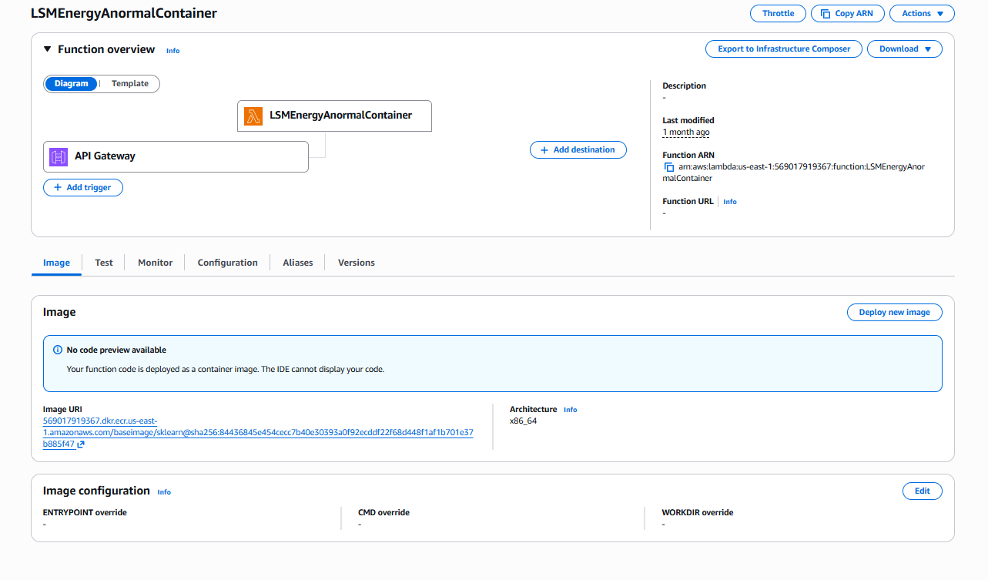
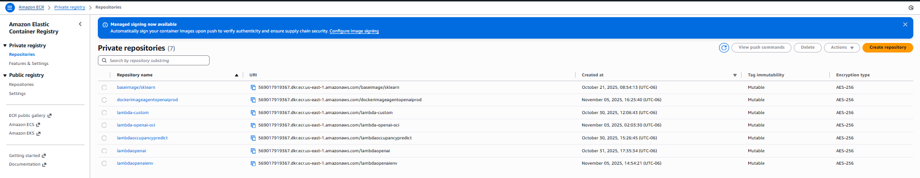
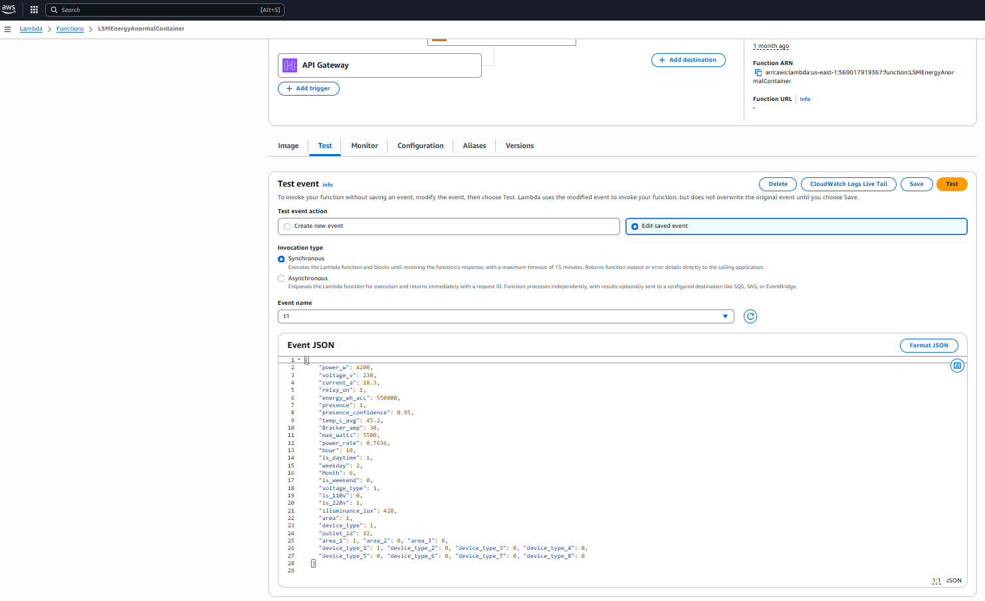
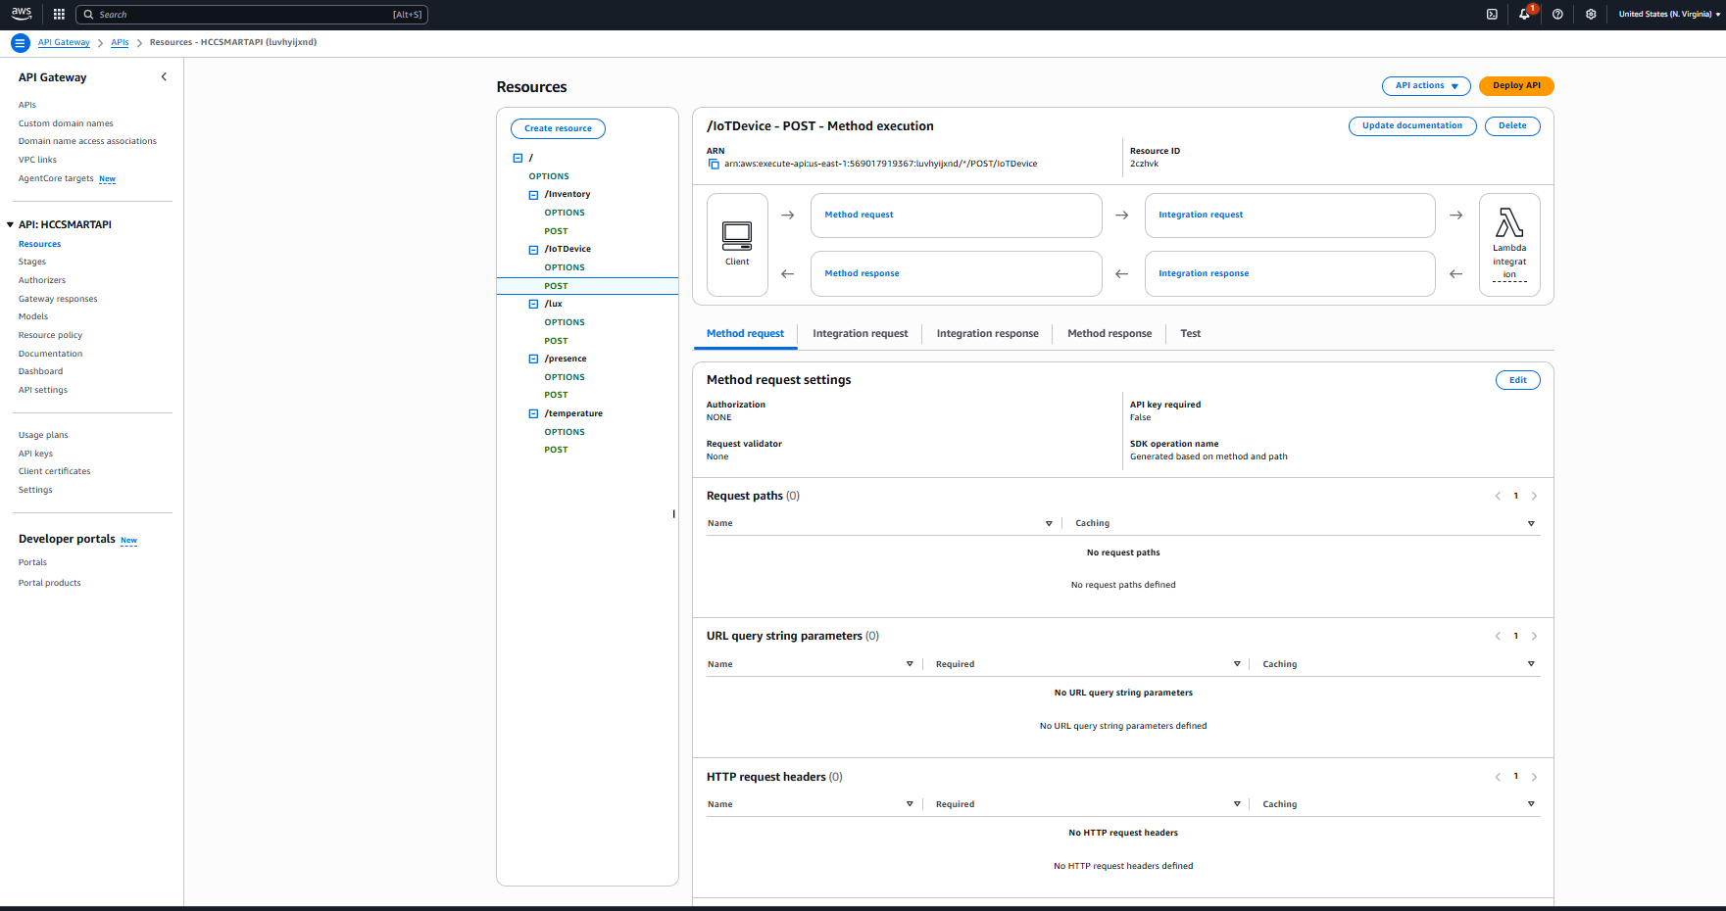
AWS Resources
Aws Lambda
Aws ECS Container
Aws API Gateway
Aws Lambda Test

Slide 19
TECHNICAL SLIDES - Database Interaction & Dynamic Query Engine (Chatbot Integration)
Smart Query Engine (LLM-Driven Database Access):
The project includes a custom chatbot powered by OpenAI that can execute dynamic SQL queries safely and in real-time.
How it Works:
The user sends a natural-language question (example: “Show me yesterday’s energy usage for Property A.”)
The prompt includes the database schema, table names, and column definitions.
The LLM generates a validated SQL query.
The system executes the query against the database and returns the results to the user.
A 30-second TTL timer is used to control execution cost.
Query sanitization is enforced to avoid injection risks.
Benefits:
Instant insights without writing SQL manually
Auto-generated analytics
Business-friendly interface
Reduced operational burden
Perfect for dashboards, reports, and mobile apps

Slide 20
Code Walkthrough (Internal Logic & Key Components)
key Components of lambda_function.py:
Model Loading:
PKL model loaded at startup
Stored as a global variable for performance
Preprocessing tools (scaler, encoder) also loaded
Event Parsing:
Lambda receives sensor payloads through API Gateway
Supports both JSON body and direct invocations
Automatic validation of required fields
Feature Construction:
Raw sensor data transformed into ML-friendly format
Normalization, scaling, missing-value handling
Derived features (hour of day, deltas, rolling windows)
Prediction Function:
Executes inference using the loaded model
Returns anomaly probability, consumption estimate, or occupancy state
Includes try/except wrappers and full CloudWatch logs
Response Serialization:
Results converted to JSON
Saved to database
Sent back to the caller through API Gateway
Extensibility: The code is structured so new models can be added easily:
Drop new PKL files into /var/task/
Add a new inference route
Update the handler to route predictions by “model type”

